Slide 1
Chapter 11
Money, Interest, and Income

Slide 2
Introduction
Money plays a central role in the determination of income and employment
Interest rates are a significant determinant of aggregate spending → Fed controls the money supply in the United States
The stock of money, interest rates, and the Fed were noticeably absent from the model developed in the last chapter
This chapter:
Introduces money and monetary policy
Builds an explicit framework of analysis within which to study the interaction of goods markets and assets market
Questions:
What determines interest rates?
What is the role of interest rates in the business cycle?

Slide 3
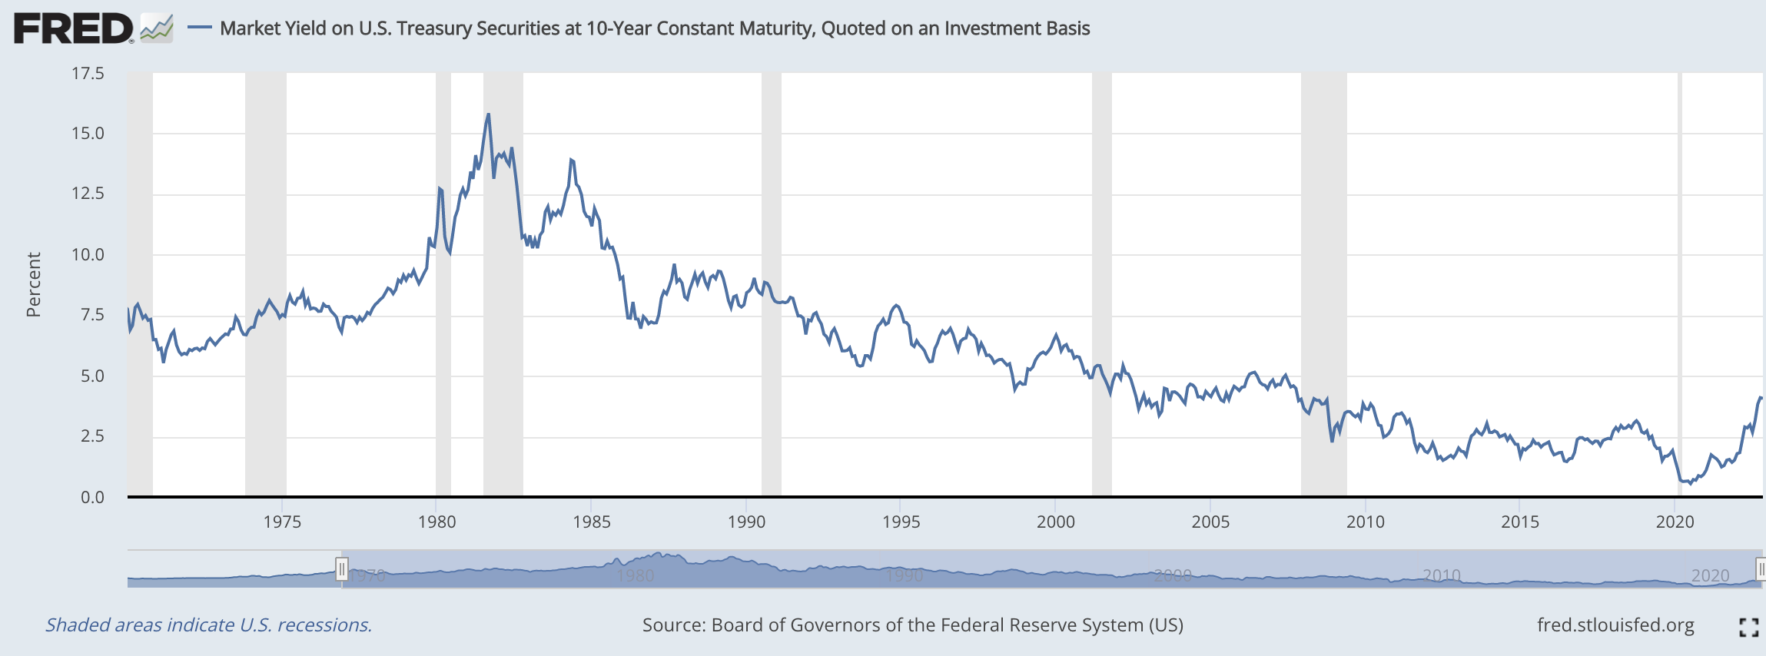
Introduction
Figure shows the interest rate on Treasury bills = the payment received by someone who lends to the U.S. government
High just before a recession, Drop during the recession, Rise during the recovery
End in November 2022: 4.07

Slide 4
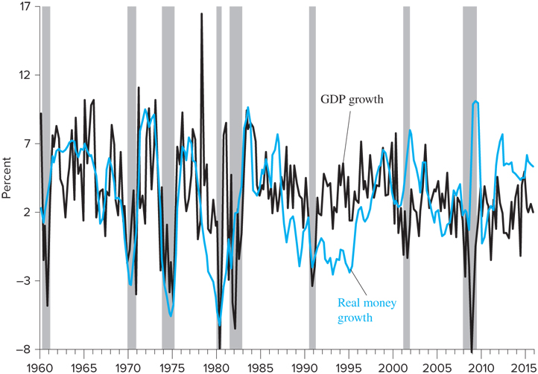
Introduction
Figure shows the strong link between money and output growth

Slide 5
Introduction
IS-LM model is the core of short-run macroeconomics
Maintains the details of earlier model, but adds the interest rate as an additional determinant of aggregate demand
Includes the goods market and the money market, and their link through interest rates and income

Slide 6
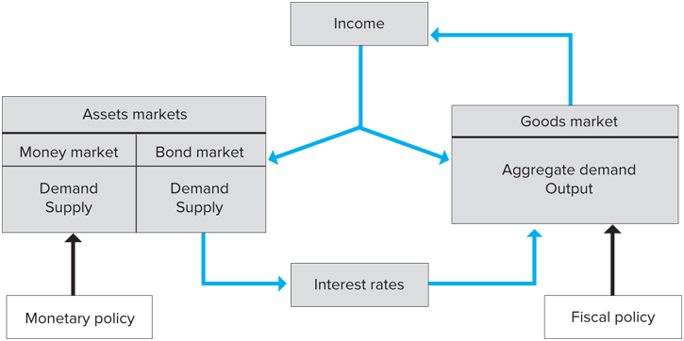
Structure of the IS-LM Model

Slide 7
The Goods Market and the IS Curve
The IS curve shows combinations of interest rates
and levels of output such that spending equals income
Derived in two steps:
Link between interest rates and investment
Link between investment demand and AD
Investment is no longer treated as exogenous, but dependent upon interest rates (endogenous)
Increased interest rates raise the price to firms of borrowing for capital equipment → reduce the quantity of investment demand

Slide 8
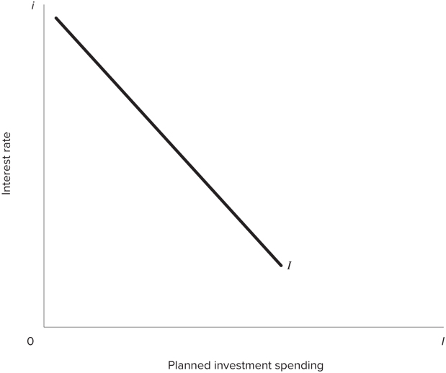
Investment and the Interest Rate
The investment spending function can be specified as:
where b > 0
b = the responsiveness of investment spending to the interest rate

Slide 9
The Interest Rate and AD: The IS Curve
Need to modify the AD function of the last chapter to reflect the new investment spending schedule:
An increase in i reduces AD for a given level of income
At any given level of i, can determine the equilibrium level of income and output as in Chapter 10
A change in i will change the equilibrium

Slide 10
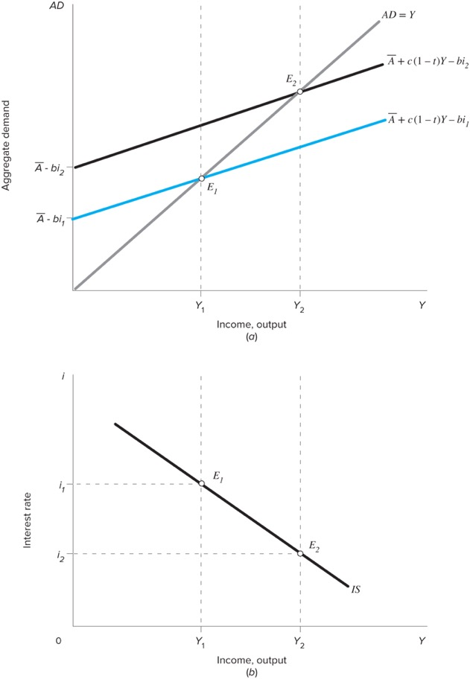
The Interest Rate and AD: The IS Curve
For a given interest rate, i₁, the last term in equation is constant → can draw the AD function with an intercept of
Figure shows the negative relationship between i and Y → Downward sloping IS curve

Slide 11
The Interest Rate and AD: The IS Curve
We can also derive the IS curve using the goods market equilibrium condition:
where , the multiplier from Chapter 10

Slide 12
The Slope of the IS Curve
The steepness of the IS curve depends on:
How sensitive investment spending is to changes in i
The multiplier, α_{G}
Suppose investment spending is very sensitive to i → b is large
A large change in Y resulting from a given change in i → IS curve is relatively flat
If investment spending is not very sensitive to i, the IS curve is relatively steep

Slide 13
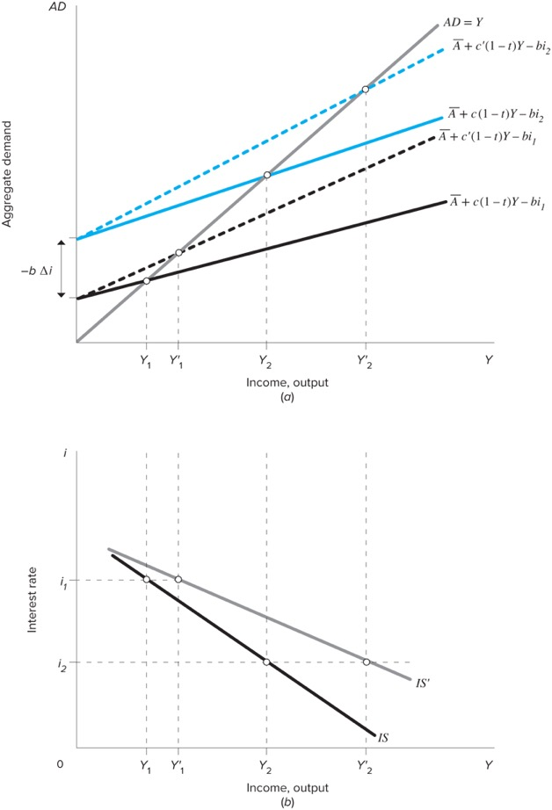
The Role of the Multiplier
Figure shows the AD curves corresponding to different multipliers
How does the coefficient c and the multiplier on the solid AD curve differs from that on the dashed AD curve???
A given reduction in i to i₂ raises the intercept of the AD curves by the same vertical distance
Because of the different multipliers, income rises to Y’₂ on the dashed line and Y₂ on the solid line

Slide 14
The Role of the Multiplier
The smaller the sensitivity of investment spending to the interest rate AND the smaller the multiplier, the steeper the IS curve as seen in the following equation:
Solving for i we have:

Slide 15
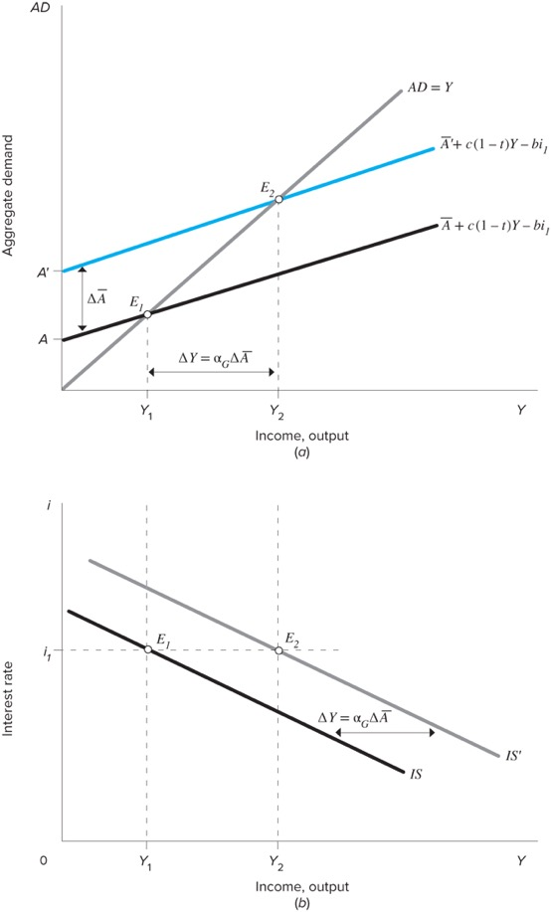
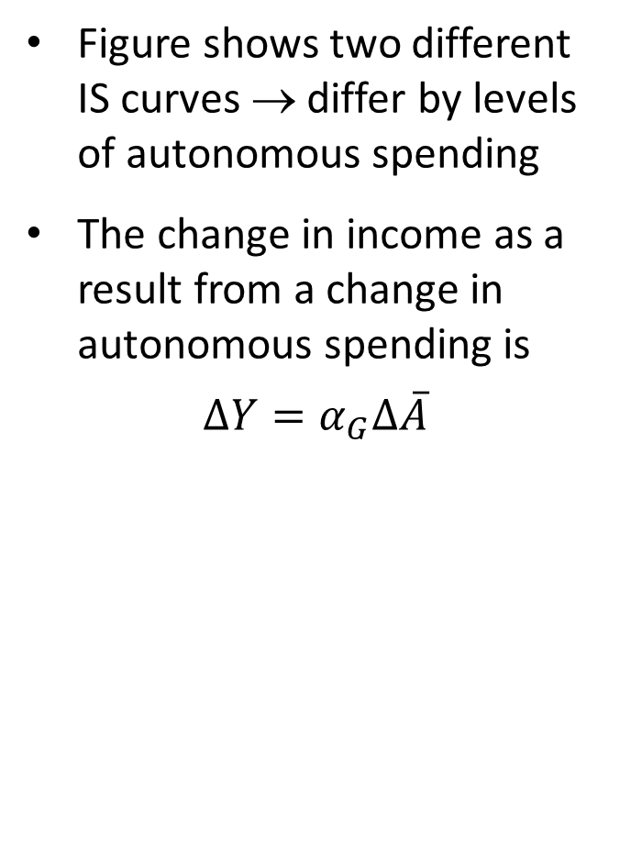
The Position of the IS Curve
Figure shows two different IS curves → differ by levels of autonomous spending
The change in income as a result from a change in autonomous spending is
$$∆Y=α_{G}∆\overline{A}$$

Slide 16

Example
The following equations describe an economy:
C = 0.8(1-t)Y
t = 0.25
I = 900 – 50i
$\overline{G}$ = 800
What is the equation that describes the IS curve?

